Slide 1

Getting Started with Data Management & DMPTool
<Your Name Here>
<Your Institution Here>

Slide 2
Overview
Why is data management important?
What is a data management plan?
The DMPTool

Slide 3
Overview
Why is data management important?
What is a data management plan?
The DMPTool

Slide 4
Why is data management important?
Data sharing allows for reproducibility, transparency, and data reuse in research.
Sharing is easier if data are managed well from the start of a project.

Slide 5






Data management & sharing mandates
Journals – PLOS, Nature, JDAP partners
Funders – NSF, NIH…
Office of Science & Technology Policy mandate, February 2013
Notes:
JDAP = Joint Data Archiving Policy
https://datadryad.org//pages/jdap

Slide 6
Overview
Why is data management important?
What is a data management plan?
The DMPTool

Slide 7
What is a data management plan?
A document that describes what you will do with your data
during your research
and after you complete your project

Slide 8
Why prepare a DMP?
Saves time
Increases research efficiency
Satisfies funder requirements
Makes reproducibility & sharing easier

Slide 9
A DMP is a living document
Keep your plan current
Incorporate changes
Use as a guide for daily activities

Slide 10
Where to start?
Small & Simple
Document what you know now
Share the plan with your team
Avoid procrastination and immobilization

Slide 11
Components of a basic DMP
Types of data
Data & metadata standards
Policies
Plans for preservation
Budget

Slide 12
Types of data
Types of data produced
Relationship to existing data
How/when/where will the data be captured or created?
How will the data be processed?
Quality assurance & quality control measures
Security: version control, backing up
Who will be responsible for data management during/after project?

Slide 13
Data & metadata standards
What metadata are needed to make the data meaningful?
How will you create or capture these metadata?
Why have you chosen particular standards and approaches for metadata?

Slide 14
Policies for access, sharing, reuse
Are you under any obligation to share data?
How, when, & where will you make the data available?
What is the process for gaining access to the data?
Who owns the copyright and/or intellectual property?
Will you retain rights before opening data to wider use? How long?
Are permission restrictions necessary?
Embargo periods for political/commercial/patent reasons?
Ethical and privacy issues?
How should your data be cited?

Slide 15
Plans for archiving & preservation
What data will be preserved for the long term? For how long?
Where will data be preserved?
What data transformations need to occur before preservation?
What metadata will be submitted with the datasets?
Who will be responsible for preparing data for preservation?
Who will be the main contact person for the archived data?

Slide 16
Budget
Costs of data preparation & documentation
Hardware, software
Personnel
Repository fees
How costs will be paid
Request funding!

Slide 17
Overview
Why is data management important?
What is a data management plan?
The DMPTool

Slide 18
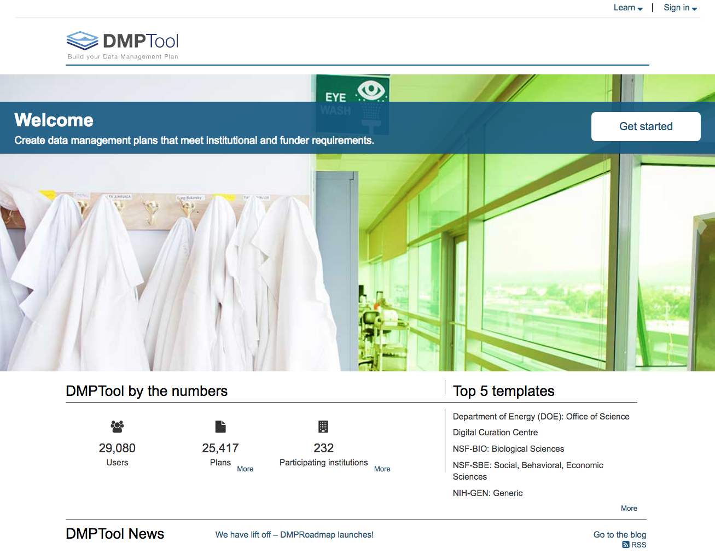

Slide 19
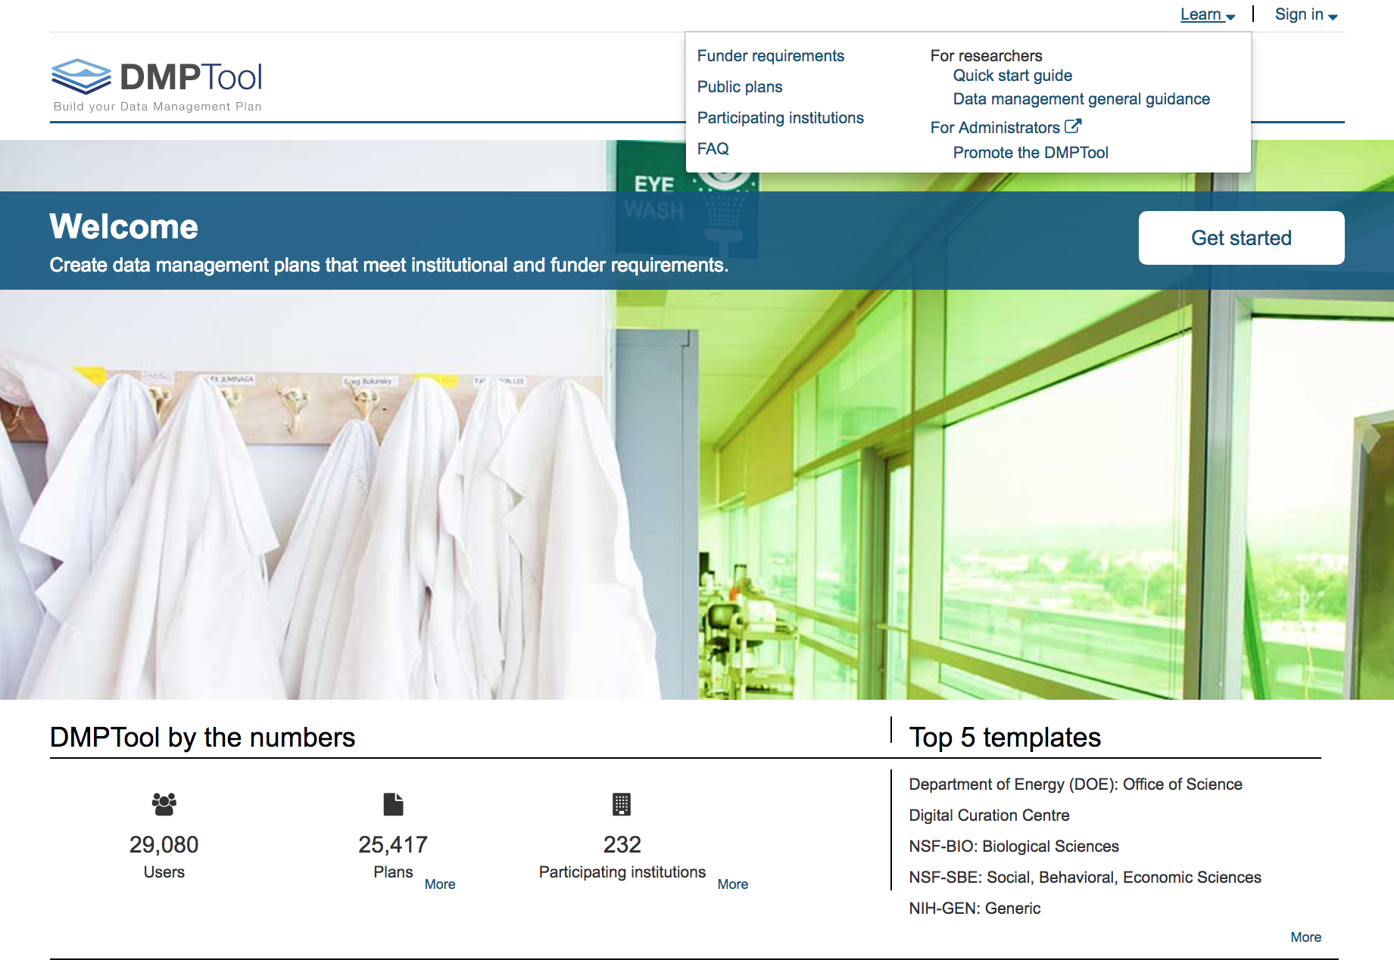
Funder guidance
Public plans
Data management resources

Slide 20
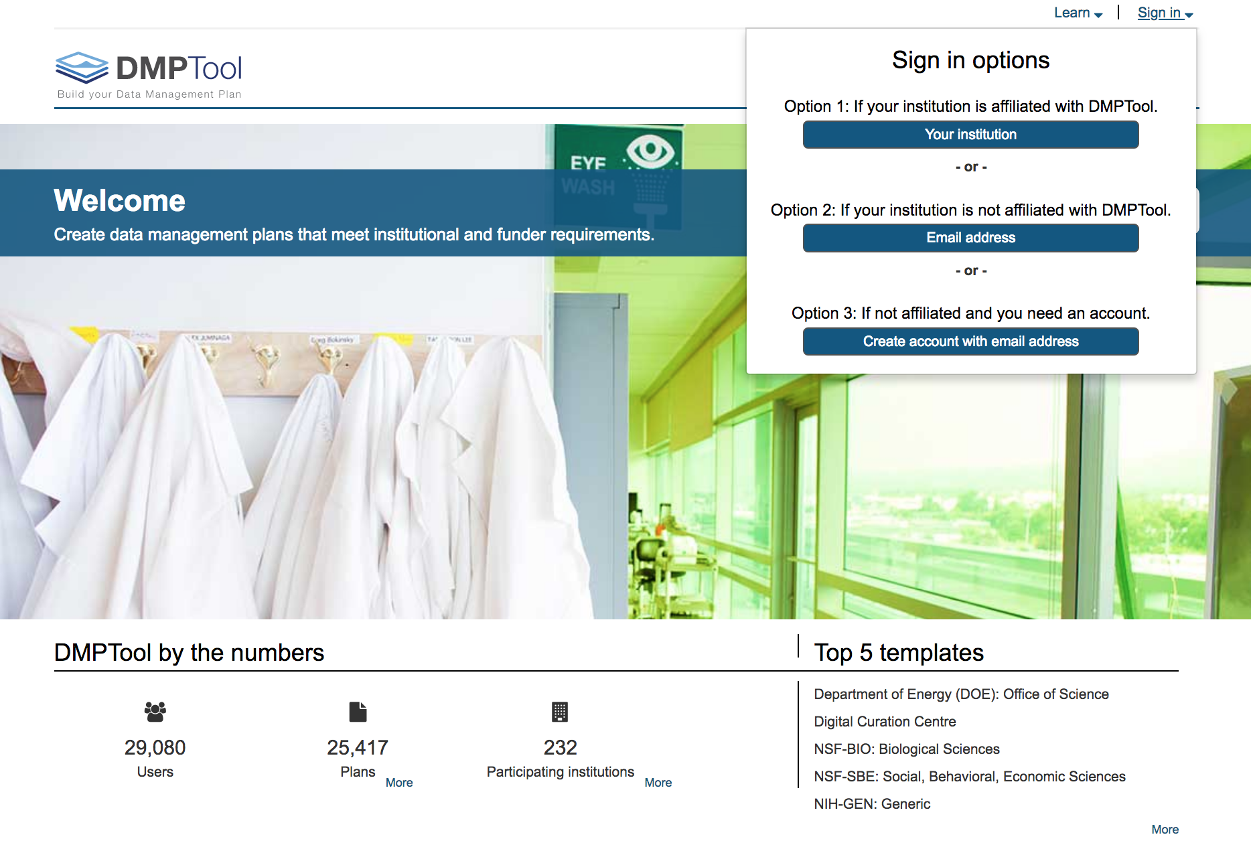
Sign in

Slide 21
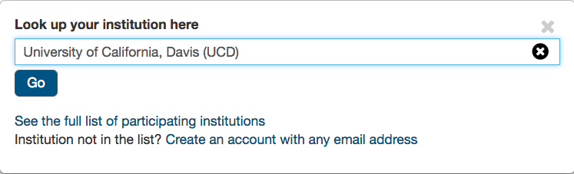
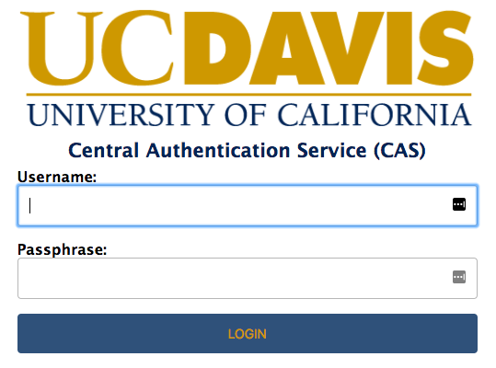
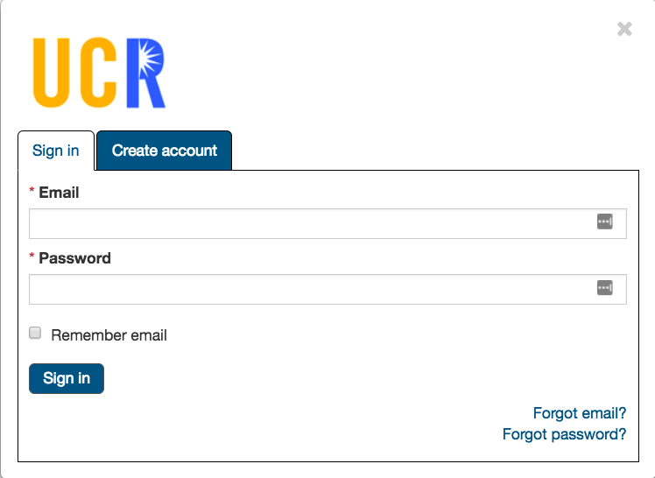
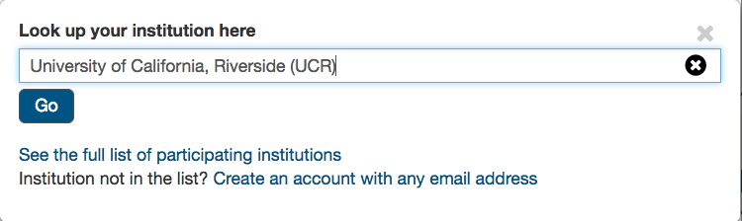
Option 1 : Single sign on (for configured institutions)
OR : Sign in with your institution using an email address
(if not configured for SSO; you must create account first)

Slide 22
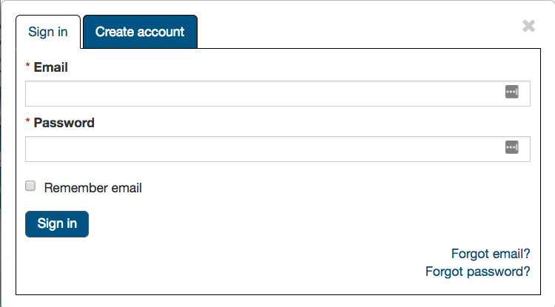
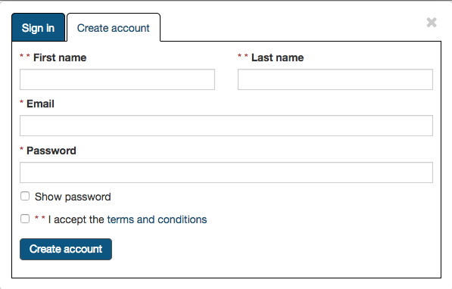
Option 2 : Sign in as an unaffiliated user
Option 3 : Create an account with an email address

Slide 23
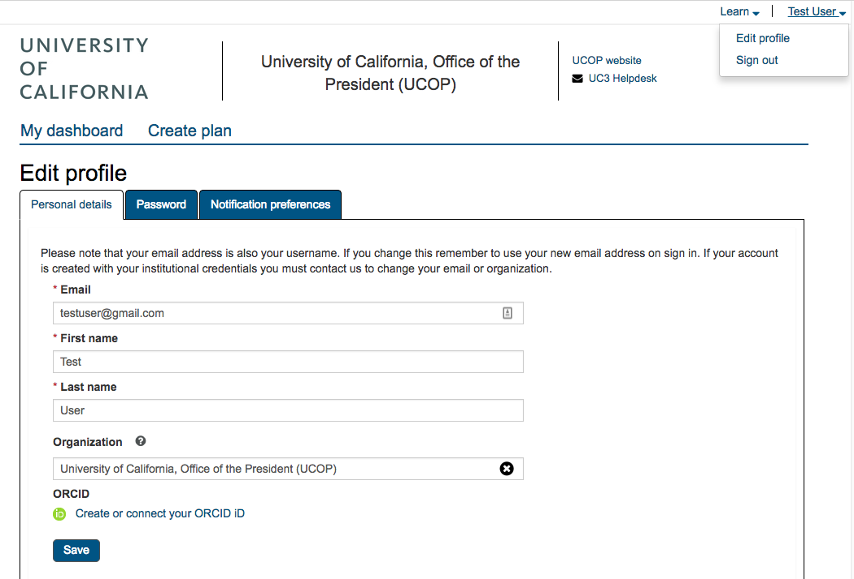
Set up your profile and notification preferences
Add your ORCID

Slide 24
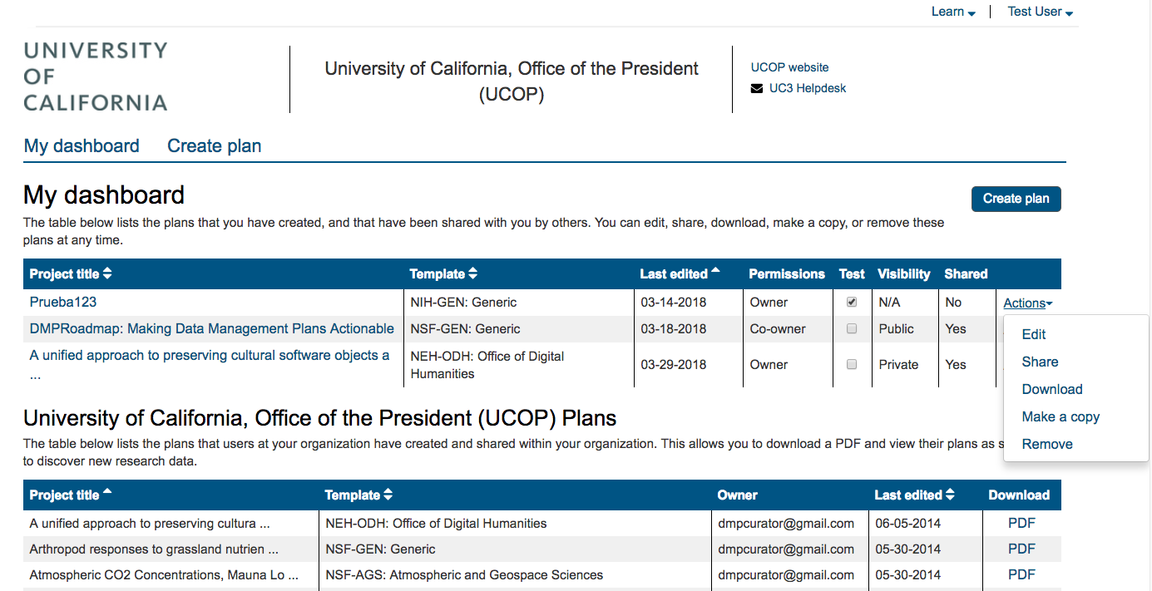
Create a plan
My Dashboard:
1. My plans
2. Plans created by others at my organization & shared internally

Slide 25
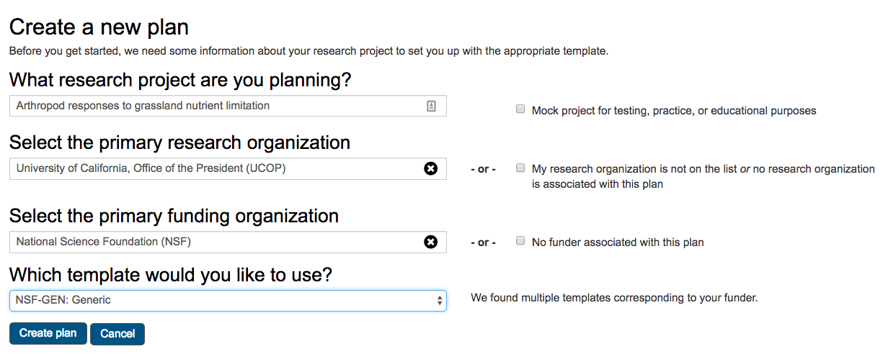
Check box below for test or practice plans
Enter project title
Select research organization
Select funder
(If a funder has multiple templates) Select template

Slide 26
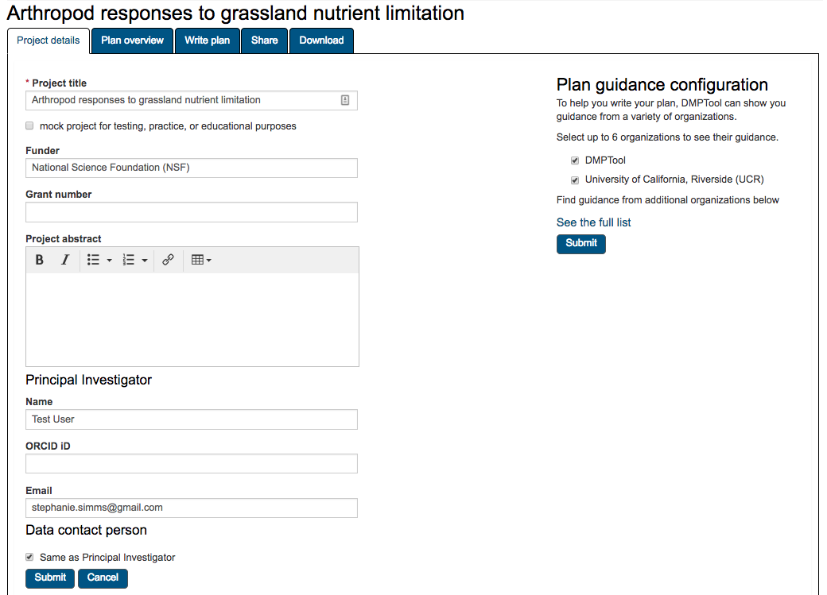
Add an abstract, other info about the project & select guidance

Slide 27
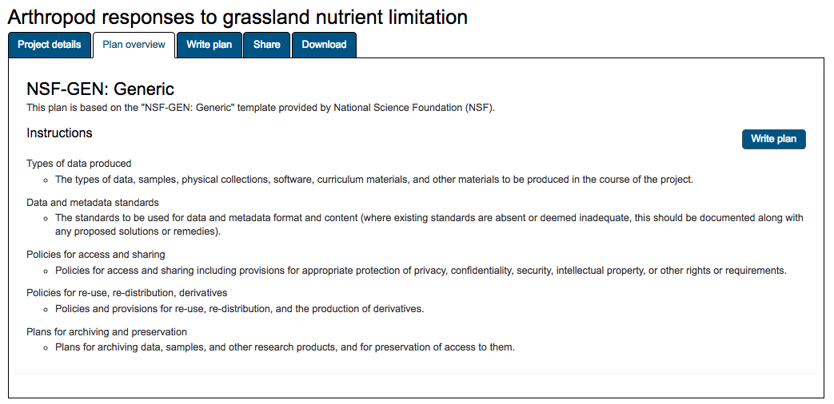
Get an overview of the questions the funder will ask you to address

Slide 28
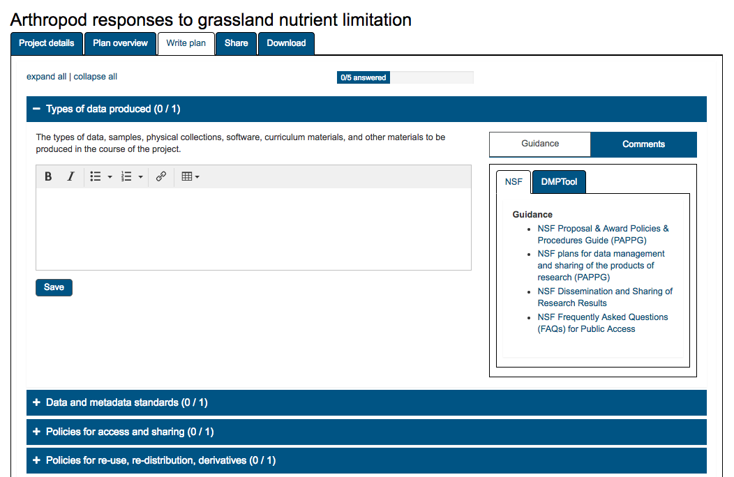
Get instructions and guidance; leave comments for collaborators
Open each accordion to answer the questions

Slide 29
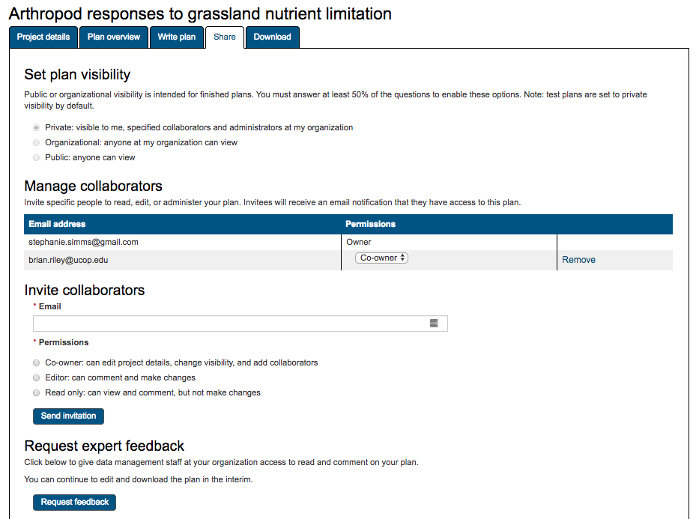
Share your plan (optional)
Invite collaborators to coauthor the plan
Request feedback (if enabled for your organization)

Slide 30
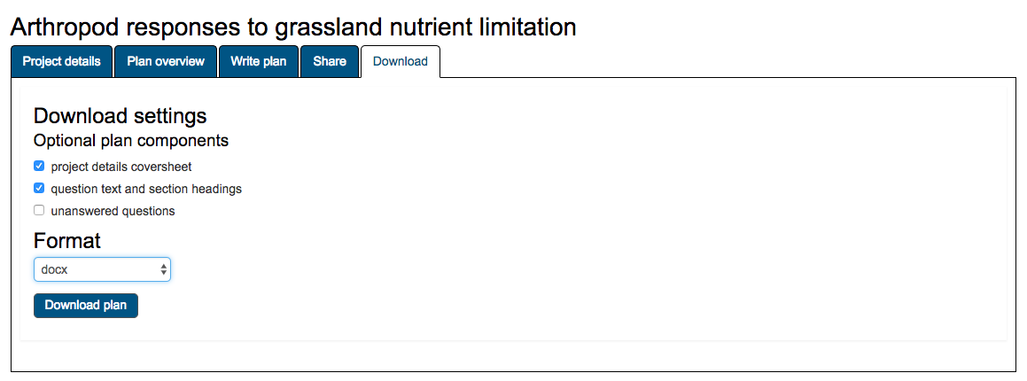
Download your plan
(docx, pdf, txt, html, csv)

Slide 31
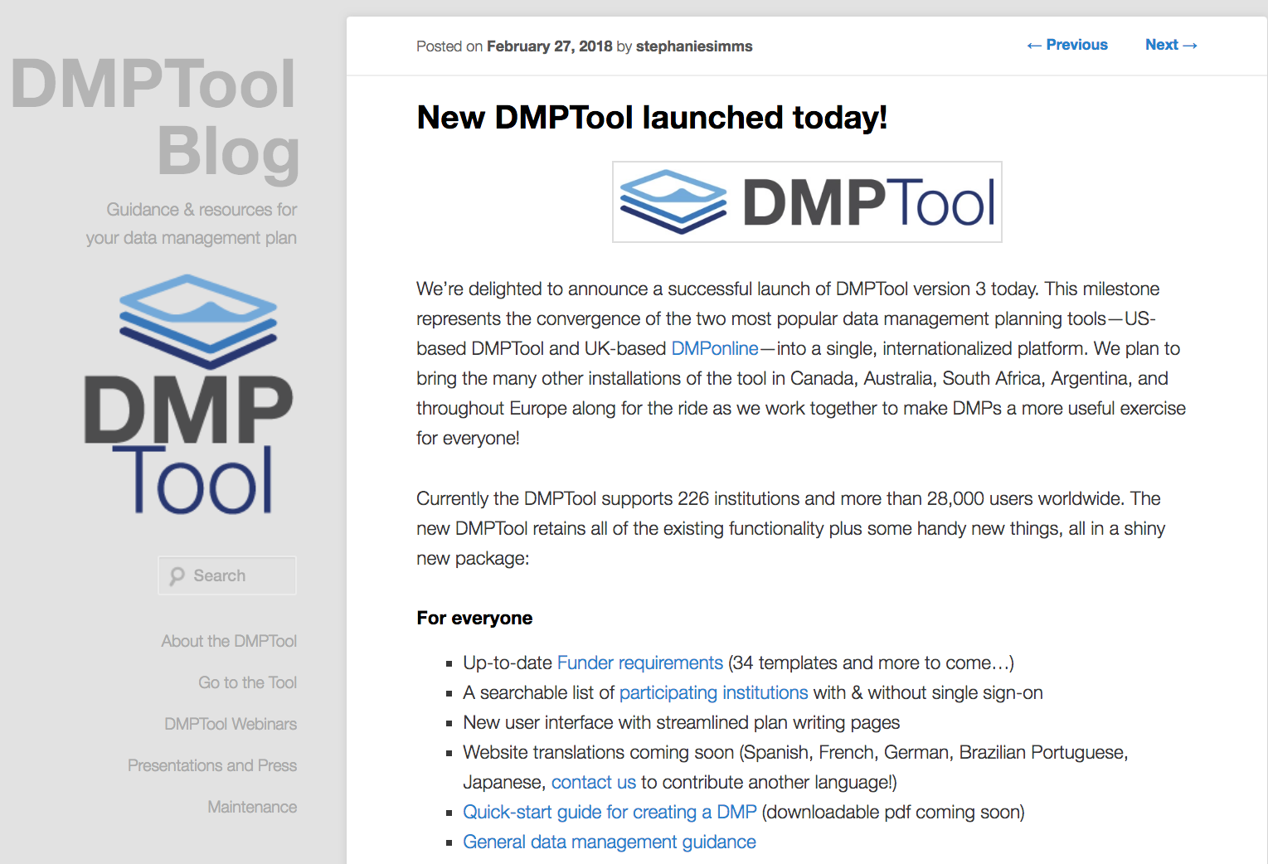
blog.dmptool.org

Slide 32
Email
Twitter
Blog
uc3@ucop.edu
<your email here>
@TheDMPTool
blog.dmptool.org

